Slide 1
Eyeball Movement based Cursor Control using python
Project By :-
Manav Lukar (211291)
Shiven Singh (211271)

Slide 2
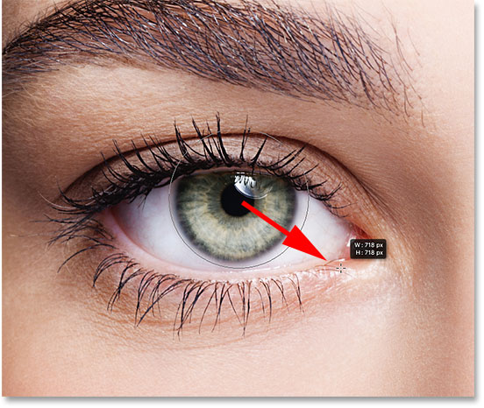


Slide 3
Introduction
Nowadays, personal computer systems take a vast part in our day to day survival since they are used in areas such as at workplace etc. but for handicapped people using computer without hands is much difficult . So a amazing thing is made for them called Eye Mouse.
‘Eye Mouse’ is the equivalent of the conventional computer mouse , but it is entirely controlled by the eyes.

Slide 4
Problem Statement
In today’s world, the computer has become a core thing and it has important usage in our daily life. But many people cannot access it due to their disabilities.
So this project is proposed for handicapped people so that they can access the cursor easily with their eyes and make the good use of computer system.

Slide 5

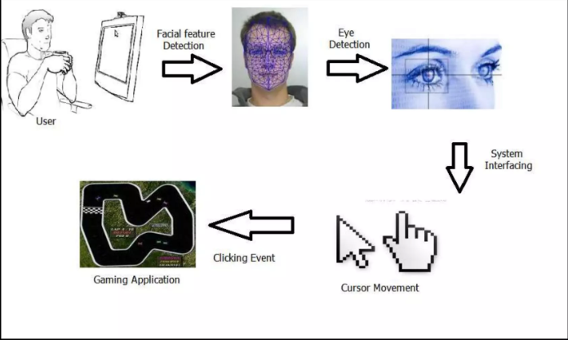

Working of eyeball based cursor

Slide 6
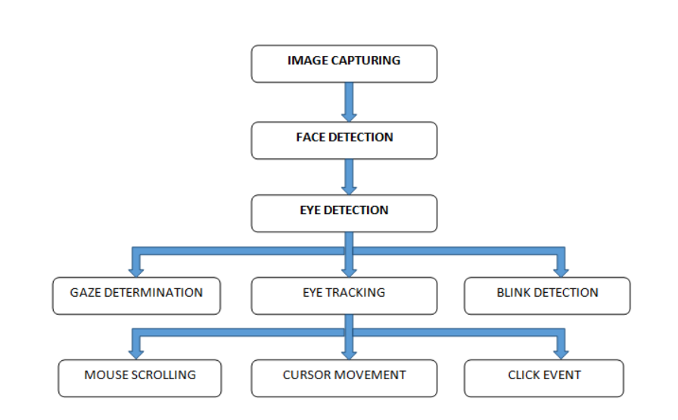
BLOCK DIAGRAM/METHODOLOGY

Slide 7
ADVANTAGES
Easier computer control
Help disabled & handicapped people to use computer
Helpful in commercial interactive games and advertisements
User friendly
Low system requirements

Slide 8
LIMITATIONS
Real time limitation
Camera Resolution
Frames captured per second
Improper usage may lead to eye problems

Slide 9
Thank You !!

